Slide 1
TRAVEL ASSISTANT CHATBOT
Using Fuzzy Logic

Slide 2

Introduction
The Travel Assistant Chatbot is an intelligent conversational system designed to simplify and personalize the travel planning experience. It uses artificial intelligence, fuzzy logic, and real-time data integration to provide users with tailored recommendations for destinations, accommodations, and activities. By understanding user preferences and queries in natural language, the chatbot can suggest the best travel routes, nearby attractions, and weather forecasts. This project aims to create a smart, interactive, and user-friendly virtual travel companion that assists users in making informed decisions for a smooth and enjoyable journey.

Slide 3
OBJECTIVES
.
To develop an AI-based chatbot that interacts naturally with users and provides relevant travel information.
To implement fuzzy logic for generating intelligent and flexible travel recommendations based on user preferences.
To integrate real-time weather data and forecasts for accurate trip planning and better user experience.
To recommend nearby places, stays, and attractions using dynamic data retrieval and contextual understanding.
To design an intuitive user interface (UI) that enhances engagement and makes travel planning interactive and enjoyable.
To enable multi-day trip planning (3/5/7 days) with detailed itineraries and activity suggestions

Slide 4
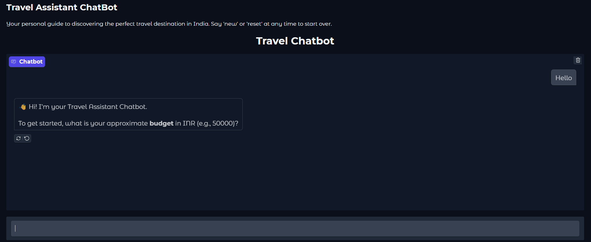

Working

Slide 5
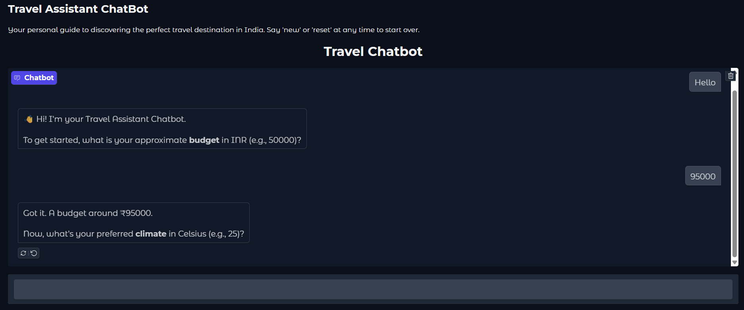
Working

Slide 6
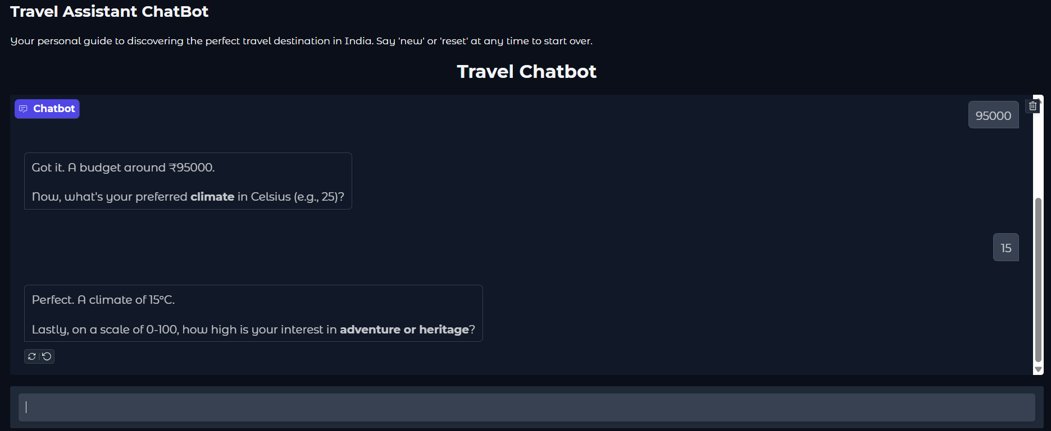
Working

Slide 7
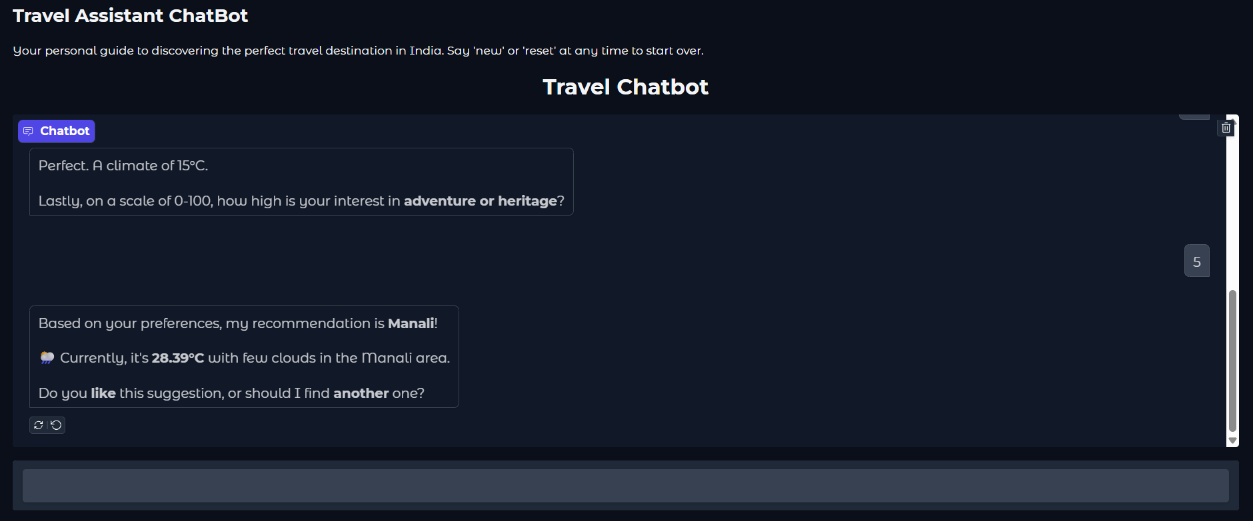
Working

Slide 8
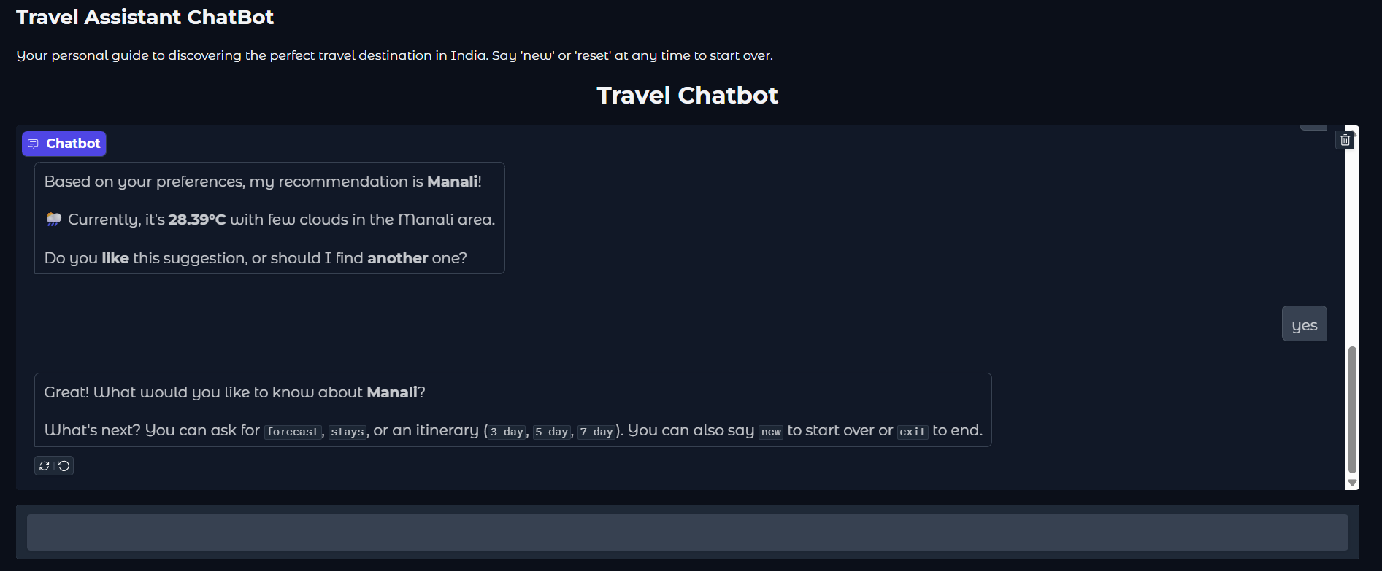
Working

Slide 9
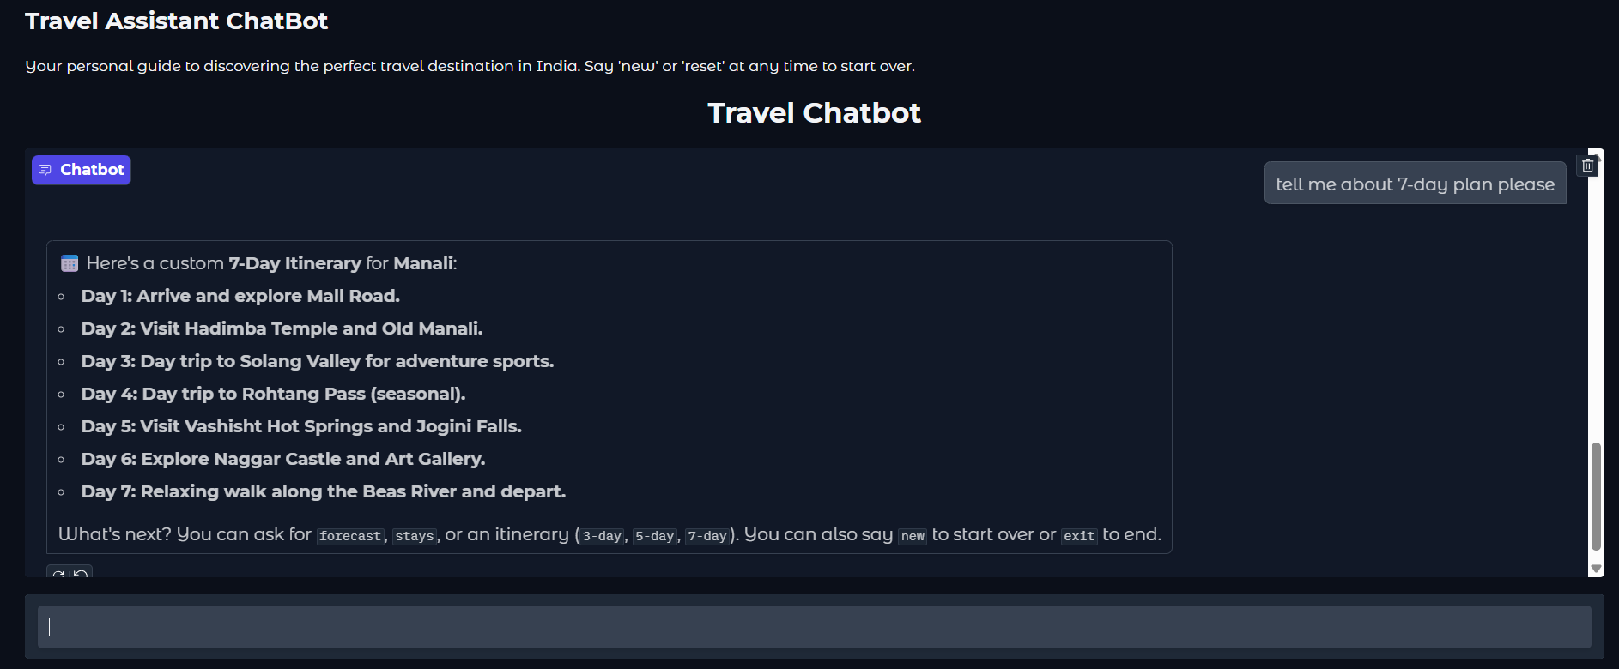
Working

Slide 10
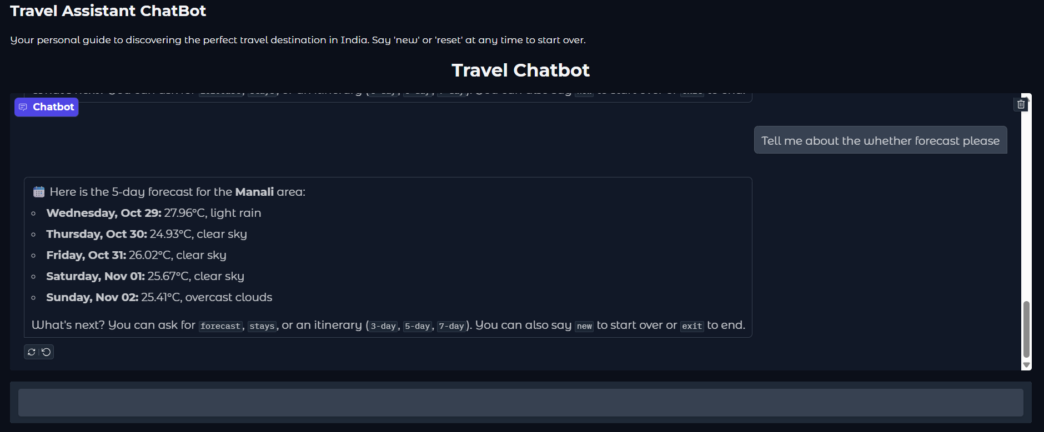
Working

Slide 11
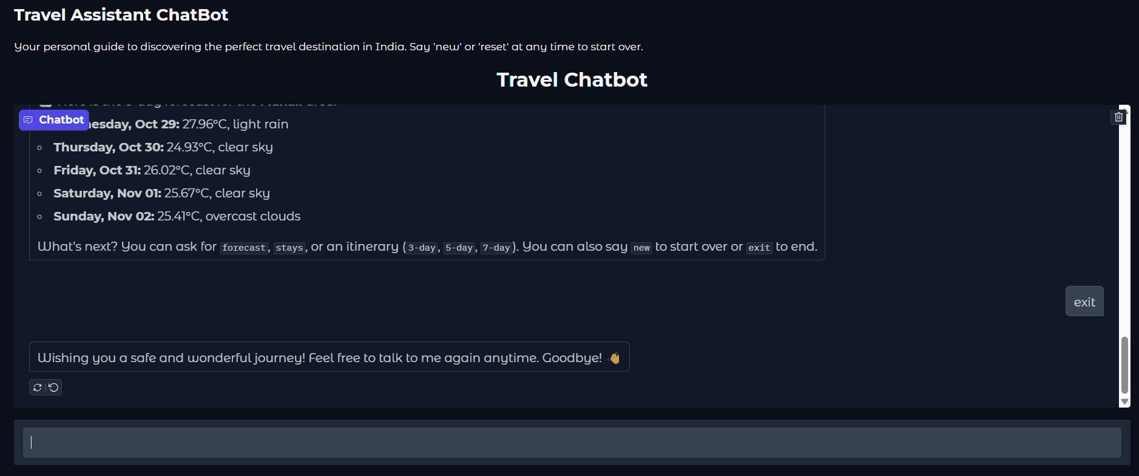
Working

Slide 12
Conclusion
The Travel Assistant Chatbot successfully demonstrates how artificial intelligence and fuzzy logic can transform the travel planning process into a personalized and interactive experience. By providing intelligent recommendations, real-time weather updates, and convenient itinerary planning, the chatbot serves as a virtual travel guide that adapts to user preferences. This project highlights the potential of AI-driven systems in tourism and paves the way for future enhancements such as multilingual support, integration with booking platforms, and voice-based interactions.

Slide 13
THANK YOU
23BCE9874
23BCE9924
23BCE9877
23BCE8498
23BCE20282

